Slide 1


Sexual Harassment at Work
Maria Macleod
Scottish Women’s Rights Centre
Notes:
Good afternoon! Thank you all for coming along to our training today on sexual harassment in the workplace.
My name is Maria Macleod, and I'm a solicitor employed by JustRight Scotland (a Human Rights and Justice law centre based in Glasgow) and I work in our Scottish Women's Rights Centre.
I'm joined by my colleague Laura, who is our Digital Training & Learning Co-Ordinator from JRS Knowhow (JustRight Scotland’s new social enterprise delivering training and learning).
So if you encounter any technical problems with the Zoom meeting, please send Laura a wee message and she'll be able to assist (or you can email her – she'll pop her email address in the chat box).
We're not recording the session today (so hopefully that makes it feel a bit more relaxed). And Maariyah has very kindly circulated the slides for today's training session – hopefully you've all received them.

Slide 2







Housekeeping
Questions via chat box or raise digital hand/ wave and unmute
You can also add questions/ comments directly to Slido​
It's okay to turn your video off if you would like to
You can click on your name>more>rename to amend your Zoom display name, role & pronouns​
Watch out for these wee icons to see how to get involved:
Raise
hand
Mic
Video
Chat box
Writing
exercise
Breakout
room
Poll
Notes:
I'm keen for you to refelect on how this might apply to your practice as we go, so if you have any reflections as we go – please pop them in the chat or raise your hand – or pop them in Slido :)
[Laura – could you explain a bit about Slido – what it is and how you can get involved].
In terms of questions: no question is a silly question, so please do ask questions as we go if something isn’t clear.
If I don't have time to answer all of your questions today, we'll make sure that we can get the answer to you after the session.

Slide 3
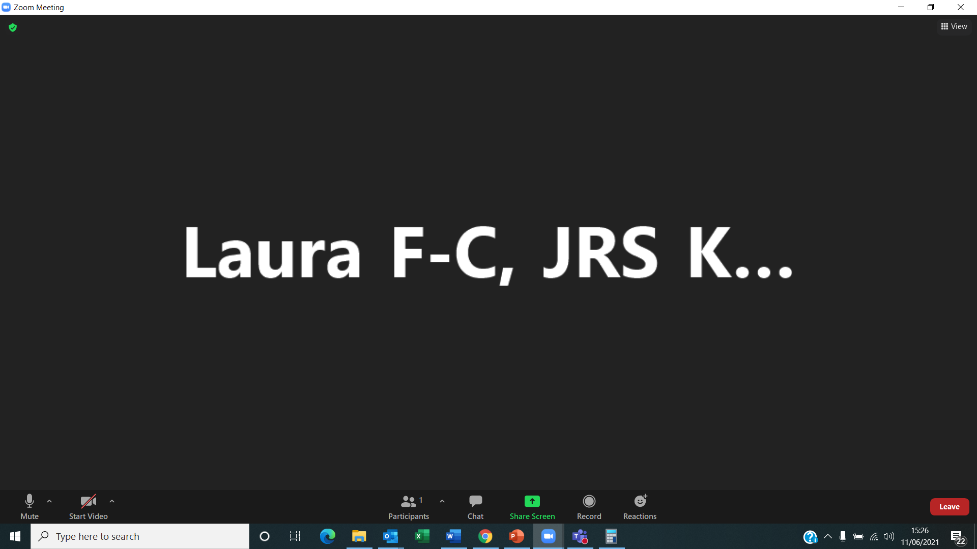
Using Zoom
Test and change your audio settings
Turn your video on and off
Bring up the participant panel
Type chat box messages
Non-verbal emoji reactions (☺) / raise hand
Leave the meeting
1
2
3
4
5
6
Notes:
In terms of using Zoom, most of you will be very familiar with Zoom but as a quick recap in case there's anyone who's spent their time since March 2020 on Teams or BlueJeans or Skype, here are some of the key functions:
Mute is in the bottom left
The chat function is in the middle
And if you want to raise your hand/ share an emoji (e.g. thumbs up, etc.) - you can click on the reactions button
If you want to leave, click the leave meeting button at the bottom right. If you accidentally leave, you can re-join using the same link and password Mariyaah emailed out to you.
I appreciate that it can be challenging learning from home – sometimes the doorbell goes, pets want to get involved - so if you need to turn your camera off at any point, please do. Although I should add that pets are always welcome and it is really nice to see your faces so if you're able to leave your camera on it would be great to see you!

Slide 4
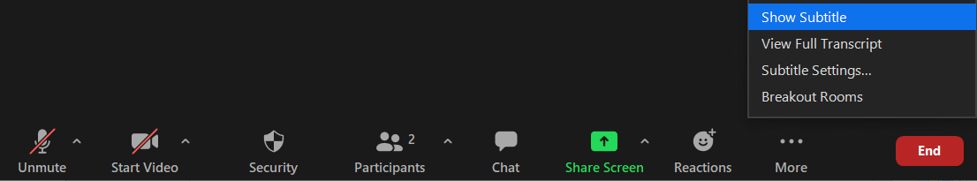
How to turn on subtitles or transcript
Select ‘… More’ in the Zoom control bar
Select ‘Show Subtitle’ in the menu
Notes:
In terms of accessibility, if you wish to read subtitles, then you can click the more button and it'll bring up the subtitles. They're not perfect but they seem to be able to understand my teuchtar accent okay so hopefully they'll be helpful if you need them.

Slide 5
Zoom shortcuts and hot keys
F6: navigate among popup windows
Alt: always show meeting controls
Ctrl + Alt + Shift+ H : show/ hide floating meeting controls
Alt +V : start or stop your video
Alt + A: mute or unmute your audio
Alt + F: enter or exit full screen
Alt + Y: raise or lower your digital hand
Alt+ F1: switch to active speaker view
Alt + F2: switch to gallery view
https://support.zoom.us/hc/en-us/articles/205683899-Hot-keys-and-keyboard-shortcuts
Notes:
Here are a wee list of Zoom shortcuts. You may already be familiar with them but, if not, you might find these useful. Particularly Alt +A if you need to mute/ unmute.

Slide 6
Agenda
1
SWRC/ Sexual Harassment Service
7
Case studies
2
Sexual harassment & employment law
3
Non-disclosure agreements
4
Employment Tribunal claims
5
Gathering information/ evidence
6
Helpful information & further resources
Notes:
So turning to what we're going to cover today:
I'll start by speaking a bit about the sexual harassment service
I'll then focus on the law, looking at:
- The Equality Act
- Third party harassment; and
- Non-disclosure agreements
We'll then turn to Tribunal claims, and information/ evidence solicitors would seek to gather
Then finally, I'll signpost you to some useful information and further resurces – before we take a break – and then apply some of that learning to the case studies.
Does that all sound okay?

Slide 7
Our objectives today
1
Be familiar with the law in relation to sexual harassment
2
Be familiar with workers' rights and employers' obligations
Be aware of what is and is not a potential legal claim and the process to access justice
3
4
Identify sources of practical support and further resources
Notes:
When we finish up today – I'm hoping that you will be:
- more familiar with the definition of SH set out in the Equality Act – and employer's obligations that flow from it (and rights that employees have)
- Be aware of the process for someone to raise a claim in the ET (if they wish to do that); and
- Be aware of helpful resources/ ways for women to access support.

Slide 8


What do you hope to learn today?
ⓘ Start presenting to display the poll results on this slide.

Slide 9




SWRC/ Sexual Harassment Service
Scottish Women’s Rights Centre
Collaboration between JustRight Scotland, Rape Crisis Scotland and the University of Strathclyde Law Clinic
We provide free legal information, advice, representation and advocacy support to self-identifying women in Scotland affected by violence and abuse.
Funded by the Scottish Government (administered by SLAB) and the TIME'S UP UK Justice and Equality Fund (administered by ROSA).
Scottish Women’s Rights Centre
Notes:
Many of you will likely know a little bit about the Scottish Women's Rights Centre as we are a collaboration between JustRight Scotland (the law firm that I work for), Rape Crisis Scotland and the University of Strathclyde Law Clinic.
. We're quite a unique project as we provide free legal information, advice, representation and advocacy support to women affected by violence and abuse.
We’re funded by the Scottish Government, administered by the Scottish Legal Aid Board, and the project I'm working on – which we'll talk a bit more about shortly – is funded by Justice and Equality Fund administered by Rosa.

Slide 10

SWRC/ Sexual Harassment Service
Sexual Harassment Service
Funded by the Justice and Equality Fund
A private fund set up following #MeToo and TIME'S UP to bring an end to the culture of harassment, abuse, and impunity.
Provide information, advice, and representation to women who have encountered sexual harassment:
At work
Online
In further and higher education
Scottish Women’s Rights Centre
Notes:
The Sexual Harassment Project has been made possible by the Justice and Equality Fund, which was set up by Emma Watson and a number of other members of the entertainment industry in response to #MeToo and times up campaigns with the aim of tackling sexual harassment – particularly in the workplace.
#MeToo
We've just passed the 4th anniversary of the #MeToo movement and it's great to be able to reflect on the progress that has been made – particularly in terms of the awareness raised of sexual harassment and its prevalence in society.
We know, from statistics published by the Government Equalities Office 2020 Survey on Sexual Harassment:
– that 29% of the working population has experienced at least one form for sexual harassment at work in the last 12 months; and
Levels of formal reporting of sexual harassment in the workplace are very low.
- Only 15% of people surveyed reported their experience formally (internally or externally), highlighting that employers are likely significantly under-estimating the amount of sexual harassment taking place.
Our Project
Our project, provides information, advice, and representation to women who have encountered sexual harassment:
in the workplace, AND ALSO
online, and
in further and higher education.

Slide 11



SWRC/ Sexual Harassment Service
SWRC Sexual Harassment Services
Legal Helpline
Legal Surgeries
Legal Representation
08088 010 789
Provide initial legal information and advice
Online Booking Form
Free 1-hour legal advice appointments via Zoom or by phone
Take-on Form
Legal representation available in cases where women require a solicitor
Scottish Women’s Rights Centre
Notes:
There are a number of ways that women can contact our service.
- And I would add that we can offer second tier advice as well. So if you need information on behalf of someone that you're supporting – please don't hesitate to get in touch.
Helpline
We provide initial information and advice to women experiencing sexual harassment through our legal helpline.
Our helpline is open on:
Monday – 10-2
Tuesday 6-8
Wednesday 10-2
Friday 10-1pm
And for advocacy support on Tuesdays between 11-2pm
Legal Surgeries
We offer free, 1-hour legal advice appointments on a Wednesday between 10-1pm.
We help women understand the law and relevant legal processes
Provide information about their legal rights; and
Outline their options so that they can decide how they wish to proceed (if they wish to take action at all); and
We can signpost to further relevant support.
Appointments can be booked by calling our helpline; and
- we've recently launched an online booking system, which you can access through our website (and by clicking on the link on the slide).
Legal Representation
And we also offer legal representation for women who require in-depth legal advice or require legal representation in court or Tribunal proceedings.
We only take on a limited number of cases – focussing on strategic cases which can have the greatest impact on the gratest number of people, and/ or there are specific gaps in terms of women being able to access justice.
Women can request to have their cases considered for take on by completing the form on our website (which can also be accessed through the link on the slide).
Does anyone have any questions about our service? Or how they can get in touch?

Slide 12
Sexual harassment and employment law
Employer duties
Two of the key duties are:
Employers must protect the health, safety and welfare of their workers
Health and Safety at Work etc. Act 1974
Employers must not discriminate against, harass or victimise their workers
Equality Act 2010
Scottish Women’s Rights Centre
Notes:
Great, so turning to the law in relationto sexual harassment:
There are many duties that an employer owes to their workers/ or employers. We can’t touch on all duties in the time we have today – but to give you a flavour of some of the obligations, they include:
1. contractual duties: (such as the implied term of trust and confidence – in every contract of employment. Employers have a duty not to act in a way that is likely to seriously damage or destroy implied term of trust and confidence – and this is a 2-way duty for both employers and employees);
2. the common law duty of care: (To take reasonable care and skill regarding the provision of a safe workplace); and
3. duties under the Employment Rights Act (e.g. They have a duty to provide protection against detriment and dismissal (and is there to protect employees taking evasive action and protective action) - which may be particularly relevant where someone is experiencing sexual harassment at work.
Today – given our time constraints – I want to draw your attention to 2 of the key duties; and I'll particularly focus on the second – duties under the Equality Act.
Firstly – Duties under Health and Safety law.
S2 of the Health and Safety at work Act states that all employers must do everything ‘reasonably practicable’ to ensure a safe and healthy workplace.
They should:
- have regular health and safety discussions; and
- remove and reduce risks.
And Secondly – where we'll focus our time today – is their duty not to discriminate, harass or victimise their workers.

Slide 13
Sexual harassment and employment law
Section 26 - Equality Act 2010:
What is harassment?
Section 26 of the Equality Act 2010 prohibits three types of harassment :
Harassment related to a relevant protected characteristic (age; disability; gender reassignment; race; religion or belief; sex; or sexual orientation);
Sexual harassment;
Less favourable treatment of a person because they submit to, or reject, sexual harassment or harassment related to sex or gender reassignment.
Scottish Women’s Rights Centre
Notes:
The Equality Act prohibits three types of harassment.
FIRST
Harassment is defined as unwanted conduct related to a relevant protected characteristic, that has the purpose or effect of violating a person’s dignity, or creating an intimidating, hostile, degrading, humiliating or offensive environment for that person.
The relevant protected characteristics for the purposes of determining harassment are:
age
race or ethnicity
religion or belief
sex
disability
sexual orientation
gender reassignment (note that the language in the Equality Act is noted by the EHRC as being outdated – and so that act uses the word gender reassignment – but the preferred umbrella term would be 'trans.'
SECOND
The second type of harassment is sexual harassment (which we'll look at in more detail on the next slide)
THIRD
And the third type of harassment is less favourable treatment of an individual because they submit to, or reject, sexual harassment or harassment related to sex or gender reassignment.
Example: less favourable treatment for rejecting harassment
A shopkeeper propositions one of his shop assistants. She rejects his advances and is the consequently turned down for a promotion which she believes she would have got if she had accepted her boss's advances.
I want to turn now to the definition of Sexual Harassment

Slide 14
Sexual harassment and employment law
Section 26 (2) - Equality Act 2010:
Sexual harassment
The definition of sexual harassment is contained in section 26 (2):
                Unwanted conduct of a sexual nature that has the purpose or effect of:
                violating a person’s dignity; or
    creating an intimidating, hostile, degrading, humiliating or offensive environment
Scottish Women’s Rights Centre
Notes:
The legal definition of sexual harassment is set out in section 26 (2) of the Equality Act.
It's defined as:
Unwanted conduct of a sexual nature that has the purpose or effect of:
violating a person’s dignity; or
creating an intimidating, hostile, degrading, humiliating or offensive environment
I want to break down this definition and consider each part separately:
1. First: Unwanted conduct of a sexual nature; then SECOND, consider the -
2. Purpose or Effect; and then THIRDLY - think about -
3. What it means to violate a person's dignity OR create an intimidating, hostile, degrading, humiliating or offensive environment?
Turning first to unwanted conduct:
UNWANTED CONDUCT
Unwanted means essentially the same as 'unwelcome' or 'uninvited'.
It does not mean that someone has to expressly object to the conduct, in order for it to be unwanted. (EHRC Code para 7.8
There is no need for a person experiencing harassment to have already made it clear that the perpetrator's conduct is unwanted for it to constitute harassment; and
A single incident can be enough to constitute harassment. (It does not need to be a course of conduct).
There may be circumstances in which a course of conduct is not unwanted in the earlier stages, but at some point ‘oversteps the mark’ and becomes unwanted.
PURPOSE OR EFFECT
PURPOSE
Whether or not unwanted sexual conduct violates a person’s dignity or creates an offensive environment, depends on the victim’s perspective and whether their reaction is reasonable in all the circumstances.
People have different reactions to sexual conduct. Behaviour that might appear harmless to one person can be more serious to another.
If the perpetrator's unwanted conduct of a sexual nature is shown to have had:
- the PURPOSE of violating the worker's dignity; or
- of creating an intimidating, hostile, degrading, humiliating or offensive environment for them,
the definition of harassment is made out and there is no need to consider if it has that effect (and the reasonableness of the perpetrator's perception is not relevant).
EFFECT
If the perpetrator's conduct isn't shown to have that purpose, then it is necessary to to look at the EFFECT of their conduct on the worker.
In assessing whether the conduct has:
- the EFFECT of violating a worker's dignity; or
- of creating an intimidating, hostile, degrading, humiliating or offensive environment for them,
- you need to consider
1. The perception of the worker (that is, did they feel that it violated their dignity or created an offensive environment for them?) - SUBJECTIVE TEST
2. You need to take into account: the other circumstances of the case, including:
-- the personal circumstances of the worker experiencing the conduct (their mental health, mental capacity, previous experience of harassment, for example)
-- whether the harasser is in a position of trust or seniority to the worker/ or holds any power over them; and
--the environment in which the conduct takes place.
+ 3. (Although the perception of the perpetrator's conduct is paramount) You also need to consider whether it is reasonable for the conduct to have that effect. - OBJECTIVE TEST
(e.g. A court or Tribunal is unlikely to find unwanted conduct has the effect of – for example – offending a worker, if it considers the worker to be hyper-sensitive and that any other reasonable person subjected to the same conduct would not have been offended.
[So, thinking about whether the conduct had the purpose or effect -
FIRST – you need to consider the purpose;
THEN – if you can't establish the conduct had that purpose, then you look at the effect it had. When looking at the effect, you're considering how the behaviour made the worker feel – their perception (which is a subjective test); AND you're considering whether it was reasonable for the conduct to have that effect (that is an objective test).]
VIOLATING A PERSON'S DIGNITY/ CREATING THAT ENVIRONMENT
It can be hard to think about what it means in real terms to violate a person's dignity.
- Essentially, the idea is that every person should be treated with respect.
In terms of the environment that's created (and by environment – we mean the state of affairs), it can also be helpful to ask yourself:
- Do you feel intimidated by the person directing unwanted conduct towards you?
- Do you feel degraded by what that person is doing or saying to you?
- Do you feel humiliated?
- Do you find it offensive?
Sometimes the first thing that people feel is uncomfortable – they feel it's not right.
- It doesn't matter if not everybody would find certain behaviour offensive.
Does that make sense?
Any questions?
I thought it might be useful to have a think about the types of behaviour that may consititute sexual harassment (so that we can put the definition into context).
Can you give me an examples of types of behaviour that may amount to sexual harassment? You can pop it in the chat box or come off mute and share...

Slide 15
Sexual harassment and employment law
Forms of sexual harassment
A wide range of behaviours can amount to sexual harassment:
Sexual comments or jokes
Suggestive looks, staring or leering
Propositions and sexual advances
Sexual gestures
Sending sexually explicit emails or text messages
Unwelcome hugging, touching, massaging and kissing
Intrusive questions about a person's sex life
Displaying sexually graphic pictures, posters or photos
Spreading sexual rumours about a person
Scottish Women’s Rights Centre
Notes:
These are just some of the types of behaviours that can amount to sexual harassment.
It could also include:
- making promises in return for sexual favours
- sexual posts or contact on social media
Now, I'm going to look briefly at the definition of Victimisation – before considering third party harassment and non-disclosure agreements – and we'll then take a break :)

Slide 16
Sexual harassment and employment law
Section 27 - Equality Act 2010:
Victimisation
Treating someone badly because:
                that person has done a 'protected act'; or
                they believe that person has done (or is going to do) a 'protected act'.
Protected acts include:
Making a complaint or claim of discrimination under the Equality Act;
Helping another person to make a claim under this Act by giving evidence or information;
Alleging that you or another person has breached this Act; or
Doing anything else in connection with this Act.
Scottish Women’s Rights Centre
Notes:
Victimisation is defined in section 27 of the Equality Act. It occurs where someone is treated badly because:
that person has done a 'protected act'; or
they believe that person has done (or is going to do) a 'protected act'.
Protected acts include:
Making a complaint or claim of discrimination under the Equality Act;
Helping another person to make a claim under this Act by giving evidence or information;
Alleging that you or another person has breached this Act; or
Doing anything else in connection with this Act.
Essentially, if you make a complaint about any form of discrimination in terms of the Equality Act – for example – if you complain about sexual harassment you've experienced e.g. to your boss, and you're then treated less favourably (e.g. you're fired, or denied a promotion) because of that complaint – it may amount to victimsation under s27 of the Act.

Slide 17
Sexual harassment and employment law
Third-party harassment
A form of harassment (related to a protected characteristic) that someone experiences at work which is carried out by a person they interact with, but that person does not work for their employer.
  For example, harassment from a customer, client or supplier.
There is currently no specific protection against third-party harassment, but employers should still take reasonable steps to prevent or respond to it.
Scottish Women’s Rights Centre
Notes:
I wanted to touch on Third Party Harassment because there used to be protection for workers from 3rd party harassment under the Equality Act but this protection was removed.
However, the UK Government pledged earlier this year to re-instate these important protections.
So, what is Third party harassment?
It is a form of harassment (related to a protected characteristic) that someone experiences at work which is carried out by a person they interact with, but that person does not work for their employer.
For example, harassment from a customer, client or supplier.
It could be a shopworker being sexually harassed by a customer; or teachers receiving harassment from their pupils or parents.
As I say, there is currently no specific protection against third-party harassment, HOWEVER, employers should still take reasonable steps to prevent or respond to it.
If they fail to do so, their response could amount to discrimination under the Equality Act.
[E.g. It could be indirect discrimination – which is when there's a practice, policy or rule which applies to everyone the same way, but it has a worse effect on some people than others. And, as women are more likely to experience sexual harassment, failure to respond to allegations of sexual harassment would have a worse effect on women – putting them at a particular disadvantage – and so could amount to indirect discrimination (for example).]

Slide 18
Non-disclosure agreements
Non-disclosure agreements (NDAs)
    NDAs (also known as confidentiality agreements) are written agreements that prevent someone from sharing information.
    There are some circumstances where NDAs may be appropriate.
    However, significant concerns arise about the potential mis-use of NDAs in sexual harassment cases.
Scottish Women’s Rights Centre
Notes:
Finally, before we take a short break, I think it's crucial to talk about NDAs when we're thinking about sexual harassment at work. You may be familiar with this term but for those who're not:
What is an NDA?
NDAs (are also known as confidentiality agreements or confidentiality clauses) and they are contracts that prevent someone from sharing information.
There are some circumstances where NDAs may be appropriate. For example, when someone starts a new job – an employer might ask someone to sign an NDA to protect company secrets.
However, significant concerns arise about the potential mis-use of NDAs in sexual harassment cases.
One of the most concerning examples of the mis-use of NDAs you will all likely have heard about is in relation to Harvey Weinstein. Zelda Perkins, a former assistant of Mr Weinstein, after almost two decades of silence, breached the terms of her NDA to speak out about the mis-use of these agreements, and the issues arising from them, particularly in cases of sexual harassment.
If you've not already seen it, I would definitely recommend checking out her campaign for legal change (which she set up with Canadian academic Julie McFarlane) – called Can't Buy My Silence.

Slide 19
Non-disclosure agreements
Non-disclosure agreements (NDAs) (continued)
    Employers should only use NDAs where it is lawful to do so.
    It is unlawful to use NDAs to prevent a worker from reporting a criminal offence, whistleblowing, or doing anything required by law.
    Legal advice should be sought prior to signing an NDA on whether the terms of the agreement are appropriate, or whether it is necessary at all.
    Where someone has concerns after signing an NDA, they can still seek legal advice about the terms of the agreement.
Scottish Women’s Rights Centre
Notes:
Confidentiality clauses are not legally binding if they try to stop someone who has been sexually harassed from speaking with the police or to a regulator.
They cannot be used to stop whistleblowing (in other words, telling your employer or someone else about anything illegal or dangerous you know is happening at work) where it's in the public interest.
And an agreement may not be legally binding if someone isn't given reasonable time to think about it and/ or get independent legal advice before signing it.
It's important to get legal advice prior to signing an NDA about BOTH the appropriateness of the terms, and indeed, whether it is necessary to have an NDA at all.
It is imperative that someone understands the full implications of signing the NDA before signing it.
If someone's signed an agreement and they're unhappy with the terms, they can get legal advice and a lawyer can speak to them about their legal options.

Slide 20

Quick break
Image credit: Jorge Margarido, Blush
Notes:
We'll take a short break now (5 mins)
If anyone has any questions, pop them in the chat/ on Slido and we can answer them after the break (or at the end). :)

Slide 21
Employment Tribunal Claims
Potential employment options
Check the employer's relevant policies and procedures.
These could include:
Lodge grievance
Contact trade union representative (if they are a member)
Seek legal advice/ representation
Contact ACAS to start the Early Conciliation process
Raise claim in the Employment Tribunal
Grievance
Bullying and harassment
Dignity at work
Equality and diversity
Whistleblowing
Sexual harassment
Scottish Women’s Rights Centre
Notes:
Now I want to look at some of the potential remedies available to people who've experienced sexual harassment at work.
There are a number of potential remedies available outwith an employment context:
E.g. people experiencing sexual harassment at work could potentially get protective orders (e.g. a non-harassment order) or could apply for compensation from the CICA/ apply to a court for damages. [Today, we only have time to focus on the remedies for sexual harassment through the Employment Tribunal but we're hopefully going to arrange two further training sessions on sexual harassment in further and higher education and online sexual harassment in the new year – so we can look at these other remedies in detail during those sessions. Or, if you would like, we can have a chat about them at the end. Please pop any questions you might have about other legal options in the chat box or on Slido.
So,
If someone has experienced sexual harassment at work, one of the first things that I would suggest that they do is to check their employer's relevant policies and procedures.
Not all companies will have a stand alone sexual harassment policy, but some of the employer's duties could be found in their:
- Grievance
- Bullying and Harassment
- Dignity at work
- Equality and Diversity; or
- Whistleblowing policies (where someone reports certain types of wrongdoing – and it's done in the public interest). (E.g. criminal offence has been committed/ someone's covering up wrongdoing).
Their policies may also be incorporated into worker's contacts of employment.
If they choose to do so, they could raise an informal greivance (and/ or a formal grievance) with their employer.
They can get support from their Trade Union representative (if they have one) or from a colleague through this process.
If they've experienced sexual harassment at work, they could potentially raise a claim in the Employment Tribunal. If so, we would recommend getting early legal advice from an employment specialist solicitor – and they can provide advice and representation through the process of raising a claim in the Tribunal. (If you want more information about how someone can do this – let me know and I can answer any questions you might have on this).

Slide 22
Employment
Tribunal
Process
Employment Tribunal Claims
3-month time limit
Contact ACAS to start Early Conciliation
Witnesses
Lodge tribunal claim (ET1)
Employer lodges response (ET3)
No fees
Case Management
Settlement
Full Hearing
Notes:
I won't touch on the Employment Tribunal process too much this afternoon – but I wanted to highlight a few things.
First – and most importantly – there is a 3 month deadline from the date of the incident of sexual harassment (or 3 months less one day from the date of the last incident of sexual harassment if there has been a course of conduct) to start the process of making a claim in the Employment Tribunal.
Prior to raising an action, a worker or employee needs to go through the Early Conciliation process with the Advisory, Conciliation and Arbitration Service (ACAS). Are you familiar with ACAS? They have a great helpline that employees (and employers) can call; and part of their service is that they offer conciliation – they try and help parties come to an agreement before – and after – a claim is lodged in the Employment Tribunal.
So, before parties can raise a claim in the ET – they must contact ACAS to start the EC process. This 'stops the clock'. Then once the EC process has concluded, employees will have at least 1 month from the date of receiving their Early Conciliation certificate to raise an action in the Tribunal.
There are no longer fees to raise an action in the ET – which were incredibly prohibitive for those seeking redress through the Tribunal.

Slide 23
Gathering information/ evidence
Information gathering
Questions a lawyer may ask about a person's experience of sexual harassment:
What happened?
What is their relationship to the perpetrator? (E.g., colleague, customer, client, ex-partner, etc.)
When did the incident(s) take place?
Where did it take place?
Is the sexually harassing behaviour ongoing?
  If so, are they safe?
  If not, when was the date of the last incident?
Scottish Women’s Rights Centre
Notes:
When we're speaking to women on our helpline or at legal surgeries, we will try to gather information about what happened to them and when. We take disclosure at their pace, in a trauma-informed way, and I thought it might be useful to talk about some of the information we'd be looking to gather so we can then advise on their options.
For example, we would want to know – what happened. At the outset, we don't necessarily need to know in any great detail – but we're looking to understand the nature of the unwanted conduct (and the effect it had on them).
We would want to understand the context – the nature of the relationship, when it took place, whether it's still occurring. Are they safe? Like yourselves, safety is our primary concern.
We're also wanting to understand when the last incident of harassment took place – so that we can advise re: potential deadlines to raise an action in the Tribunal (if they wish to do so). I would also note that even though the deadline to raise an action is 3 months less one day – it's possible to extend the time limit in discrimination claims where it is just and equitable to do so.

Slide 24
Gathering information/ evidence
Information gathering (continued)
Do they have a written contract of employment?
Does the employer have a policy relating to incidents of sexual harassment?
Are they a member of a trade union? If so, have they sought advice from their union representative?
Have they spoken to a colleague?
Have they:
  Reported the incident(s) to their employer?
Raised a grievance?
  Contacted Acas?
  Raised an action in the Employment Tribunal?
Scottish Women’s Rights Centre
Notes:
We'd also want to establish if the employer has any policies or procedures that relate to how they should handle reports of sexual harassment. Whether they have a contract of employment that encorporates any of these policies (if they have any) - some employers don't.
And we'd want to understand what support they're receiving – both from Rape Crisis/ other support organisations – and from their Trade Union rep (if they have one).
And ultimately, we want to understand what action (if any) they've taken so far.
That way, we can provide the most detailed information about their legal rights and the options available to them.

Slide 25
Gathering information/ evidence
Gathering Evidence
    It is useful for people who've experienced sexual harassment at work to:
Keep a note of:
  Date(s) and time(s) of the incident(s)
  What happened
  Where it took place
  Who was involved
  Any friends or witnesses who saw what happened or the effect it had on them.
  Any support accessed, e.g., GP or counsellor.
Keep copies of any texts or emails the harasser sends; screenshots of any social media/ online incidents; and photos.
Scottish Women’s Rights Centre
Notes:
For anyone who's experienced sexual harassment, we would always recommend that, if possible, they:
Keep a note of:
Date(s) and time(s) of the incident(s)
What happened
Where it took place
Who was involved
Any friends or witnesses who saw what happened or the effect it had on them.
Any support accessed, e.g., GP or counsellor.
Keep copies of any texts or emails the harasser sends; screenshots of any social media/ online incidents; and photos.
It may seem counter-intuitive to ask someone to hold on to messages that might be distressing, but it may be essential in order to provide evidence for an investigation or legal proceedings in the future.

Slide 26

Helpful information & further resources
Helpful information and further resources
    ACAS:
    - Sexual harassment
  - Early conciliation
  - Grievance procedures
    Equality and Human Rights Commission:
    - Sexual harassment in the workplace
    - EHRC technical guidance on sexual harassment
    Support organisations
  - SWRC advocacy support
  - Rape Crisis Scotland helpline
- SWRC list of support services
Image credit: Elina Cecilia Giglio, Blush
Scottish Women’s Rights Centre
Notes:
To finish off this section, before we take a break, I wanted to include some links to some further resources:
I'd particularly recommend the ACAS website (and also the CAB website can be helpful as well), and if you're really keen, I'd recommend checking out the EHRC Technical Guidance that was launched last year.
Before we head off for a break, does anyone have any questions about anything that we've covered in this section – or anything so far?
You don't need to ask now – happy for you to pop a question on Slido and we can chat about it at the end :)

Slide 27
Quick break
Image credit: Jorge Margarido, Blush
Notes:
Now, we can work through some of our case studies. I'll read through them first and then we'll pop you into break out rooms to discuss them in smaller groups...

Slide 28
Case Studies
Case Study 1
    Amal works in an office with a culture of banter that she often feels is inappropriate, although everyone else seems to enjoy it.
    She receives an email from a colleague which includes sexually suggestive comments.
    When she raises it with her employer, she's told she can't take a joke.
    She's asked to sign something to draw a line under the matter, and is told if she doesn’t sign immediately, they will have to reconsider a promotion she's been promised.
    Since the incident, she's been approached by ex-colleagues with similar experiences.
    She wants to help but is worried about breaching the agreement.
Scottish Women’s Rights Centre

Slide 29
Case Studies
Case Study 2
    Barbara works in a bar on a zero-hours contract, but usually works 15 hours a week. As a condition of her visa, she has no recourse to public funds.
    She gets on well with the regulars. They ask her about her life, and they joke around together.
    Recently, their questions have been getting personal, and one regular makes sexual comments to her.
    When she tells her manager, he says it's important to keep them happy, and there's nothing he can do – he suggests she laughs it off. He jokes that she should expect it, looking the way she does.
    She doesn’t push it any further as she's worried she won't get hours if she upsets her manager.
    The owner of the company hears rumours that Barbara is thinking of making a complaint and dismisses her as he doesn't want to have to deal with it.
Scottish Women’s Rights Centre

Slide 30
Case Studies
Case Study 3
    Catriona has a brief sexual relationship with her supervisor. After some time, she tells him that she thinks it was a mistake.
    He doesn’t take her seriously and continues to send her messages as if they are still together, including sexually suggestive emails to her work account.
    He calls her in for a meeting in his office under the pretence of a work matter, but when they are alone, he grabs her and accuses her of playing hard to get.
    She tells him that he shouldn’t be touching her like that, and reiterates that the relationship is over, and that she isn’t playing hard to get.
    After that, he starts giving her more work to do than her colleagues, moves her away from the projects she is most interested in, and is openly critical of her in front of her colleagues.
    He also begins to spread rumours about Catriona having an affair with another one of their colleagues.
Scottish Women’s Rights Centre

Slide 31
Case Studies
Case Study 4
Danielle recently started a new job and, while she is in training, she is being supervised by her colleague, Ewan.
He creates opportunities to be alone with her and, while they are alone, makes comments about her appearance. He tells her that she will likely get promoted soon as she’s so good looking.
He leans over her when he is showing her how to do something on the computer and brushes against her.
There are no witnesses to this, and Danielle feels that she can’t complain to her employer, given Ewan is friends with her supervisor, and Danielle has been noticing that he gets preferential treatment.
Danielle decides to leave and has heard from a friend that she might be able to raise an employment tribunal claim against her former employer.
Scottish Women’s Rights Centre

Slide 32
Case Studies
Case Study Exercise
    Task: in breakout rooms, read the case study that has been assigned to your group.
    Consider the following :
Whether the behaviour might amount to sexual harassment
Barriers to reporting/ taking action
Where you might signpost the women to access support and advice
    Instructions: assign a note taker and someone who is happy to feed back at the end.
    Time: 15 minutes
    Let us know if you would like help - we can join your breakout room.
Scottish Women’s Rights Centre

Slide 33




We are done!
Questions?
Notes:
- Any questions you think about after, pop them in the Slido and can answer them later.

Slide 34

Q&A Session
ⓘ Start presenting to display the audience questions on this slide.

Slide 35
What do you hope to do differently as a result of today?
ⓘ Start presenting to display the poll results on this slide.

Slide 36
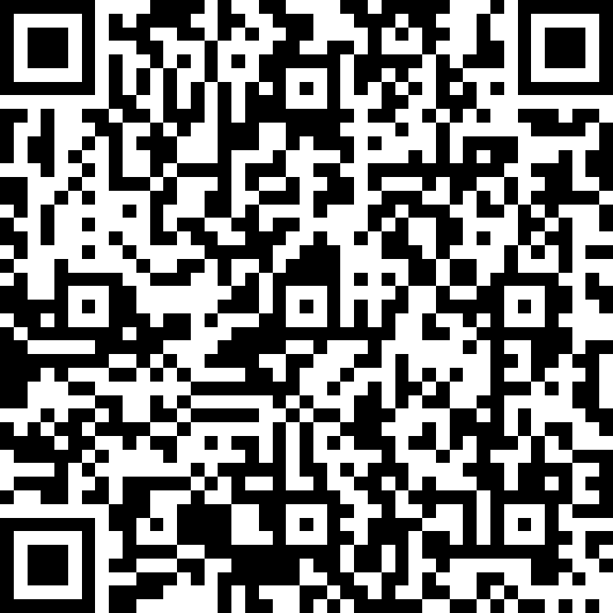
Your feedback
Link to survey:
https://forms.office.com/r/bFA5qv6ZtU
QR code:

Slide 37



Thank you!
Follow us on social media:
@SWRC_
/swrcscot
/swrc
WWW.SCOTTISHWOMENRIGHTSCENTRE.ORG.UK | WWW.FOLLOWITAPP.ORG.UK

